Slide 1
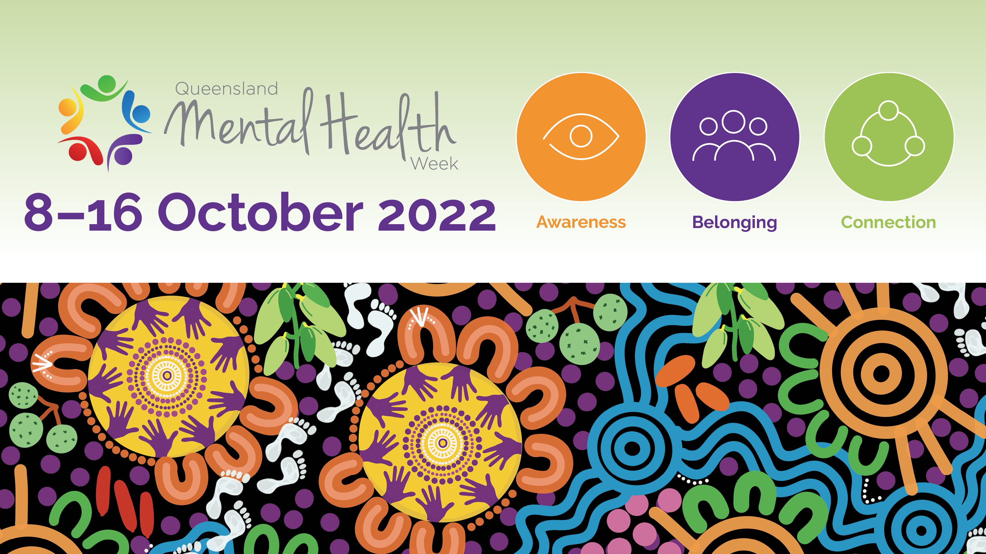

Slide 2

Acknowledgement of Country
We pay respect to Aboriginal and Torres Strait Islander Elders, past, present and future. We also acknowledge the important role played by Aboriginal and Torres Strait Islanders as the First Peoples, their traditions, cultures and customs across Queensland.
Acknowledgement of artist
The artwork informing the visual identity for Queensland Mental Health Week 2022 and featured throughout this presentation is ‘Stronger connection creates strong health’ by proud Mayi woman Leah Cummins.

Slide 3

Click to enter information

